Slide 1
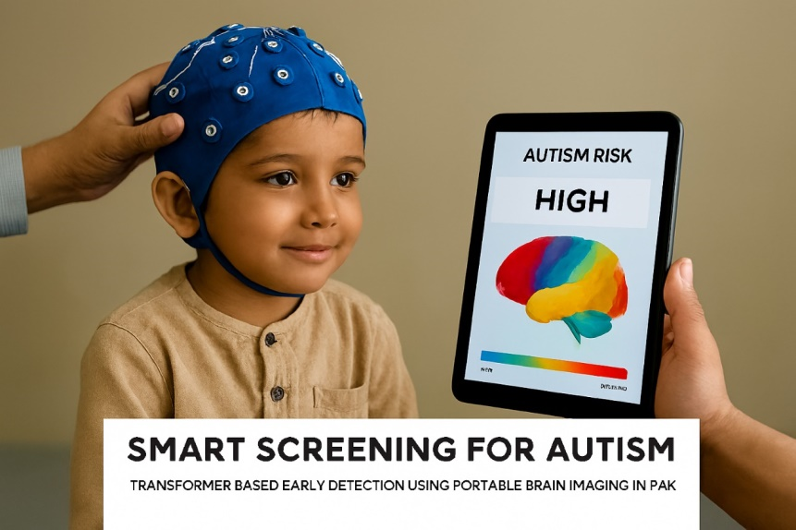
Smart Screening for Autism Transformer Based Early Detection Using Portable Brain Imaging in Pakistan
Notes:
Please keep the title brief and specific. You may place relevant graphics/images on the slide; a project picture would be preferred.
Set the stage with storytelling
Make it easy to understand
Look into the future

Slide 2
Pitch
Our team aims to develop a low-cost, portable screening kit to help detect autism early in children so they can get the right support at the right time.
We’ll build an offline tablet app that connects to fNIRS caps and runs our autism screening model locally
Primary users: health workers, pediatric clinics, NGOs in Sindh and Balochistan.
Outcome: faster triage, earlier intervention, reduced travel and diagnostic delay
Notes:
My organization, (name of company)”]
to help (target audience) [identify demographics e.g. “women age between 25 to 35 years”, “system administrators at small technology businesses”]
(solve a problem) [specify your market e.g. “reduce the time collecting bill payments”]
(with secret sauce) [clarify the buyer e.g. "by sending automated email alerts based on analysis of highest response times"]
Ref: https://fi.co/madlibs

Slide 3
Introduction
PROJECT TEAM
Summaya Razzaque
Rohma Sajid
MUET,Jamshoro
THEMETIC AREA
AI for Healthcare, neurodevelopmental screeing
ORGANIZATION
AURA
(Autism Recognition & Understanding via AI)
OBJECTIVES
Validate cross‑modal fMRI–fNIRS mapping
Deploy 10 pilot kits
Train local health workers.
Notes:
EdTech, Fintech, HealthTech, Agri/ClimateTech, GovTech

Slide 4
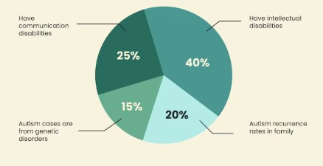
The Problem
Early ASD diagnosis is inaccessible outside major cities; MRI is costly and centralized. Behavioral assessments are subjective, delayed, and often culturally misaligned. Rural families lose critical early intervention windows and face financial and emotional strain.
Notes:
What is the problem you are trying to solve? Be Specific. Infographics may be added.

Slide 5
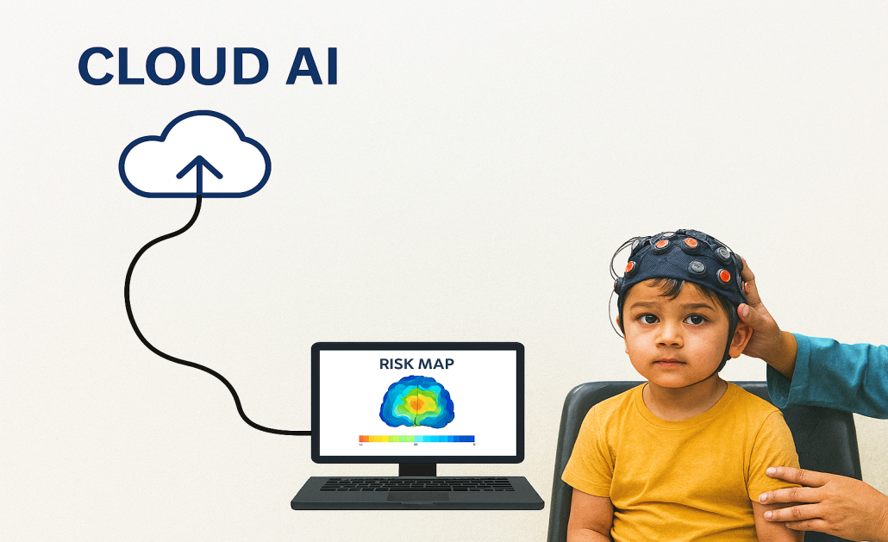
The Solution to the Problem
We've trained our AI model using high-resolution fMRI data to detect early signs of autism. Now, we're shifting to fNIRS a portable and affordable technology that makes brain screening to the clinic floor.
With the right funding, we aim to launch a nationwide network of smart screening kits run by local health workers, powered by cloud-based AI, and built to identify autism early, even in the most remote areas of Pakistan.
This isn’t just innovation,it’s inclusion.
“lets built a way to see what others miss.”
Notes:
What is your solution to the problem? A relevant image/graphic describing the product would be preferred IF ANY.

Slide 6
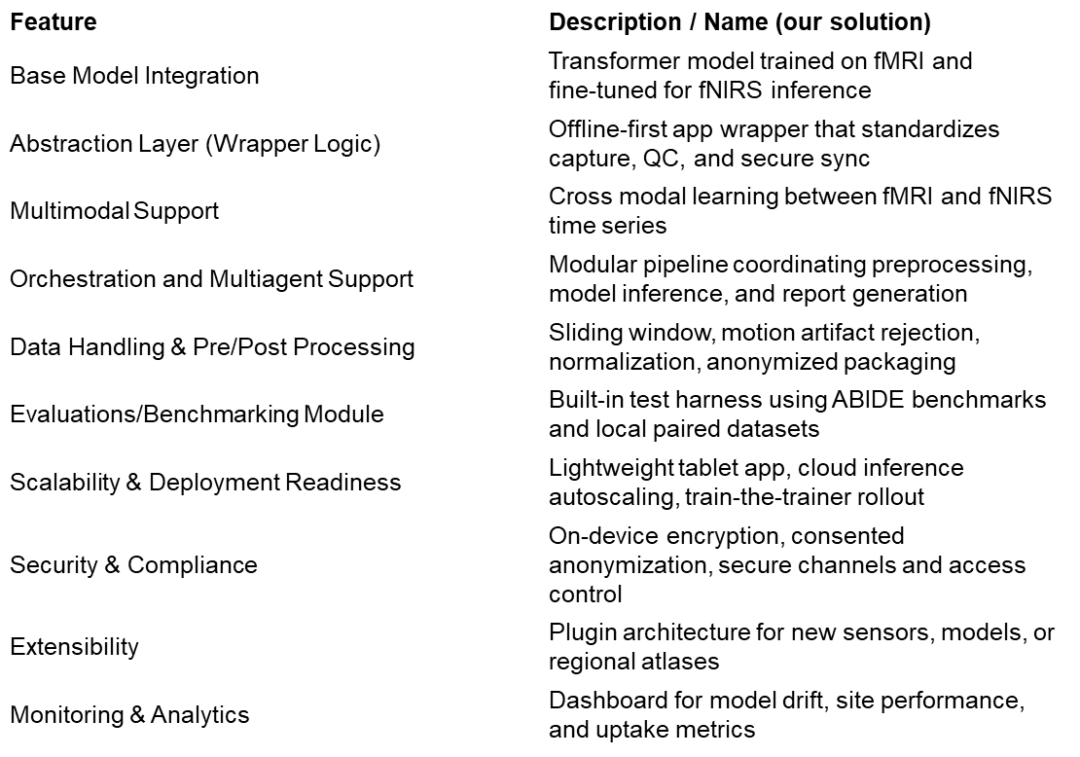
AI Wrapper Technologies

Slide 7

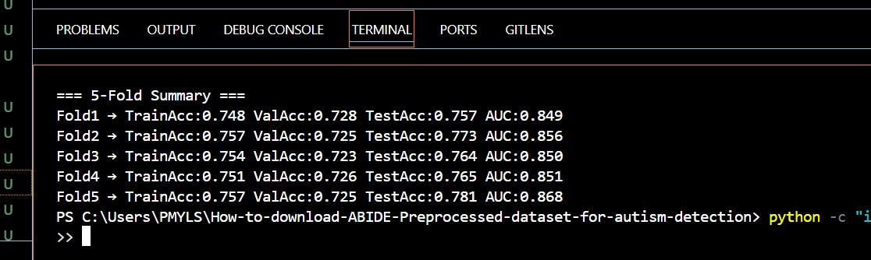
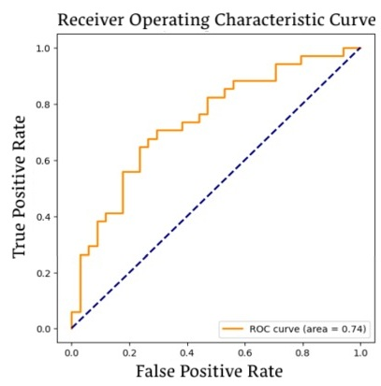
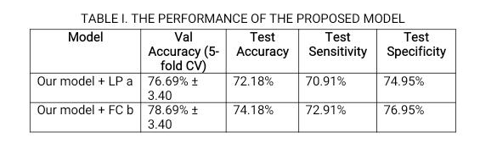
Live Demo

Slide 8
Impact
Impact: Reimagining Autism Screening for Every Child
Fast and Easy Detection Our AI system gives results in less than 10 minutes no specialist needed.
Works Anywhere The app runs without internet and supports Urdu, perfect for remote clinics.
Small Kit, Big Reach A portable fNIRS device and smart app fit in a backpack ready to go anywhere.
Empowering Local Health Workers Clinics can now do brain based autism screening without sending children to big hospitals.
Equal Chance for Every Child no matter where they live deserves early support and care.

Slide 9
Thank You!

